Slide 1
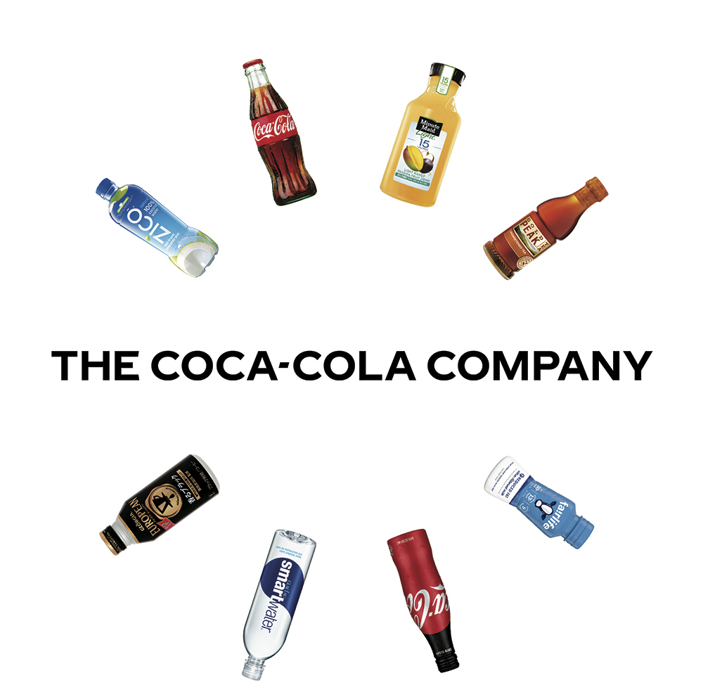
Marketing Plan
The Coca-cola Company

Slide 2
Executive Summary
Effective marketing is vital for any business.
The effectiveness of the adopted marketing strategies defines a business’ success.
All businesses face marketing challenges, for example The Coca Cola Company.
Effective marketing strategies should be developed and implemented to solve the marketing challenges.
Notes:
Effective marketing is essential for any business in the global and local market. This is because it defines the success and position of the business in the environment. Irrespective of the magnitude of any company, it is bound to face various marketing challenges. For instance, when focusing on the Coca Cola Company, a globally known brand, has also faced different marketing challenges. Consequently, this has led to the need to develop marketing objectives and strategies to improve its products' relevance.

Slide 3
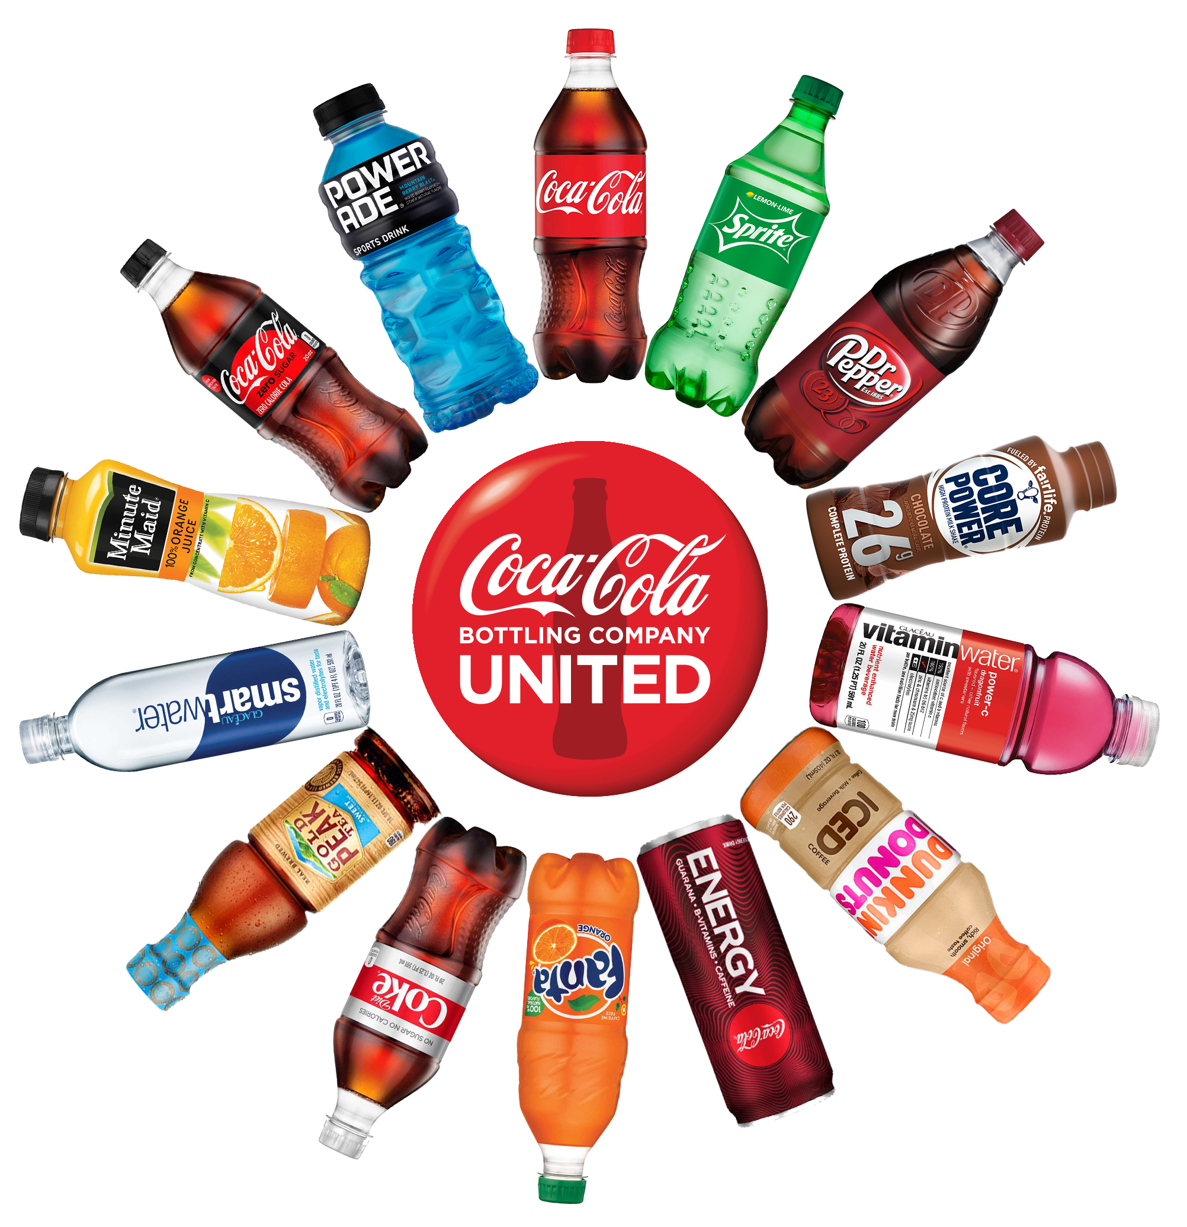
Company Profile
The Coca-Cola Company is an American Corporation introduced in 1892.
It manufactures and sells syrup, concentrate for Coca-Cola, sweetened carbonated and citrus beverages.
It has more than 2800 products available in more than 200 countries globally.
The company has faced various marketing strategies, for instance remaining relevant to the ever changing market.
Notes:
Introduced in 1892, the Coca-Cola Company is more than a century old. It is headquartered in Atlanta Georgia. The company is globally known, with about 2800 products selling in more than 200 countries. Similar to all other companies, the Coca-Cola Company also faces a variety of challenges, including marketing strategies. For instance, having its products remain relevant to the ever changing market.

Slide 4
Situational Analysis
Being more than a century old, the Coca-Cola company enjoys incredible brand awareness and strong brand legacy in the market.
However, it also has disadvantages bringing about challenges, for example having its products remain relevant in the current market.
There is need to develop marketing objectives, based on research to help solve the challenges.
Notes:
Having been introduced in 1892, it enjoys various advantages associated with the existence in the market for over a century. For instance, vast brand awareness, strong brand legacy among others. Similarly, due to the age of the company, it also has various challenges that result in challenges. For instance, the company struggles to remain relevant in the continually changing environment (Chua et al., 2018). Consequently, there is the need to conduct research and develop effective marketing strategies to help solve the challenge.

Slide 5
Marketing Objectives
For survival in a business environment, developing and implementing marketing objectives is vital.
The Marketing objectives developed for the Coca-Cola Company include:
By the end of 2021, the Coca Cola Company will develop three products that accommodate healthy beverages products
By the end of January 2022, the Coca Cola Company will introduce promotional activities to award loyal customers.
By the end of 2022, the Coca Cola Company will have employed price elasticity to mainstream the target market price
Notes:
Developing marketing objectives is a vital step towards improving a company's competitive advantage in an industry. Marketing objectives facilitate the increase of a company's products, improve its awareness among the target market, and in some scenarios, facilitate the ongoing brand management by maintaining the company's prominence in the public place (Vinerean, 2017). In this case, developing marketing objectives aimed at solving the Coca Cola Company's marketing challenges should be focused on specific sectors since the organization is already prominent in the public space, with people globally aware of its products.

Slide 6
Research
Research is required to effectively implement the developed marketing objectives.
To accomplish the first objective, a research on the various new markets existing in the industry is conducted.
To achieve the second objective, a detailed research on implementing promotions as part of marketing.
Achieving the third marketing objective will require detailed research on the effectiveness of price elasticity among beverage companies.
Notes:
According to Morgan et al. (2019), most customers, especially the young generation, are continually shifting from consuming sugary carbonated drinks to healthier beverages, creating new markets. Moreover, according to Vinerean (2017), promotions create and define the mode of communication between the company and the customers, for it reminds and the customers of the organization’s products. Furthermore, failure to adopt price elasticity, a company faces competitive challenges from competitor companies who reduce prices as a method of product differentiation.

Slide 7

Target Markets
The developed marketing objectives are aimed at youths as the target market.
Youths are the target market since they have the potential to consume most of the products.
Considering children and the elderly, most are prohibited from consuming sugary carbonated drinks due to health concerns.
The marketing strategies aim at addressing current trends among youths.
Notes:
The outlined marketing objectives are aimed at the youth as the target market, including both genders. In the current market, most of the elderly and children are discouraged from the consumption of sugary carbonated beverages for their well-being. Therefore, the youth have the potential to consume the products presented by the Coca Cola Company, both the newly developed and the already existing (Brondoni, 2019). Precisely, the developed marketing strategy aimed at entering a new market is aimed at addressing the current trends mostly associated with the youths, who are moving towards the consumption of healthier beverages.

Slide 8
Marketing Mix
Marketing mix is a technique to improve a company’s marketing matrix.
It refers to tactics used by an organization to promote its products or brand in the market.
It involves four elements, including:
Product
The Coca-Cola Company has a vast product portfolio consisting of carbonated beverages, still and sparkling drinks.
Distribution
The company has immerse distribution channels of its products in over 200 countries globally.
Notes:
The marketing matrix is an essential strategy that makes up a business plan facilitating its success. Moreover, all the outlined elements influence each other (Dost et al., 2019, 64). In this case, the organization under consideration is the Coca-Cola Company, which, based on research, has faced various challenges related to marketing.

Slide 9

Marketing Mix Continuation
Pricing
This element defines the profits of the company.
The Coca-Cola Company prices its products based on the value placed on the products by the customers.
Promotion
The company exists in an intensely competitive environment.
The Coca-Cola Company spends a large amount of finances on advertising its products for sales increase.
Notes:
The Coca-Cola Company sets product prices by combining two significant methods: competition-based and customer value-based pricing. The competitive factor also influences the pricing element since the major competitor of the Coca Cola Company is Pepsi.
The company has also diversified its promotion techniques; for instance, in 2016, the company conducted a campaign, Taste the Feeling that united all brands under the Coca Cola Company. Moreover, the company also utilizes the internet platform to promote its products, including its social media accounts. For instance, the company's YouTube platform has over 1250 promotional videos of Coca Cola, its leading brand.

Slide 10
Implementation Plan
to effectively implement the developed objectives, an implementation plan is developed.
An implementation plan facilitates the organization and development of steps towards goal achievement. It includes:
Resources allocation, for instance, the financial resources, skilled personnel.
Definition of the team’s individual responsibilities.
Notes:
In the implementation phase, all the required resources will be assembled. Precisely, some of the resources include financial resources to cater for the cost of developing a new product and introduce promotional activities. The established required personnel have specific responsibilities that will aid in the achievement of the goals. Each of the personnel will be assigned duties since they are part of the team. For instance, marketing experts will be required to develop and implement effective marketing strategies.

Slide 11
Evaluation Plan
Monitoring and evaluation is required to ensure the achievement of the established marketing objectives.
An evaluation plan ensures the implemented activities are aimed at achieving objectives.
Various success indicators are used in the evaluation plan, including:
Client satisfaction.
Sales indicators.
The net profit.
Notes:
The evaluation plan is essential to ensure that all the implementation strategies and activities are directed towards the achievement of the developed goals. It employs success indicators such as client satisfaction will indicate success in the developed product and also additional promotional activities, sales indicators, whereby an increase in sales will indicate success of the introduced products and a steady increase in the sales will mean success in increasing the number of loyal customers. Moreover, net profit will also be used, whereby an increase in the net income will depict the success of the introduced healthy products, increased loyal customers, and the positive influence of price elasticity.

Slide 12
References
Brondoni, S. M. (2019). Shareowners, Stakeholders & the Global Oversize Economy. The Coca-Cola Company Case. Symphonya. Emerging Issues in Management, (1), 16-27.
Chua, Y., Kee, D. M. H., Alhamlan, A., Lim,. Y., Lim, Y., Lim, Y., & Singh, N. (2018). Challenges and Solutions: A Case Study of Coca-Cola Company. Journal of the community development in Asia, 3(2), 43-54.
Dost, F., Phieler, U., Haenlein, M., &Libai, B. (2019). Seeding as part of the marketing mix: word-of-mouth program interactions for fast-moving consumer goods. Journal of Marketing, 83(2), 62-81.

Slide 13
References Continuation
Morgan, N. A., Whitler, K. A., Feng, H., & Chari, S. (2019). Research in marketing strategy. Journal of the Academy of Marketing Science, 47(1), 4- 29.
Vinerean, S. (2017). Content marketing strategy. Definition, objectives, and tactics. Expert Journal of Marketing, 5(2).

